Slide 1
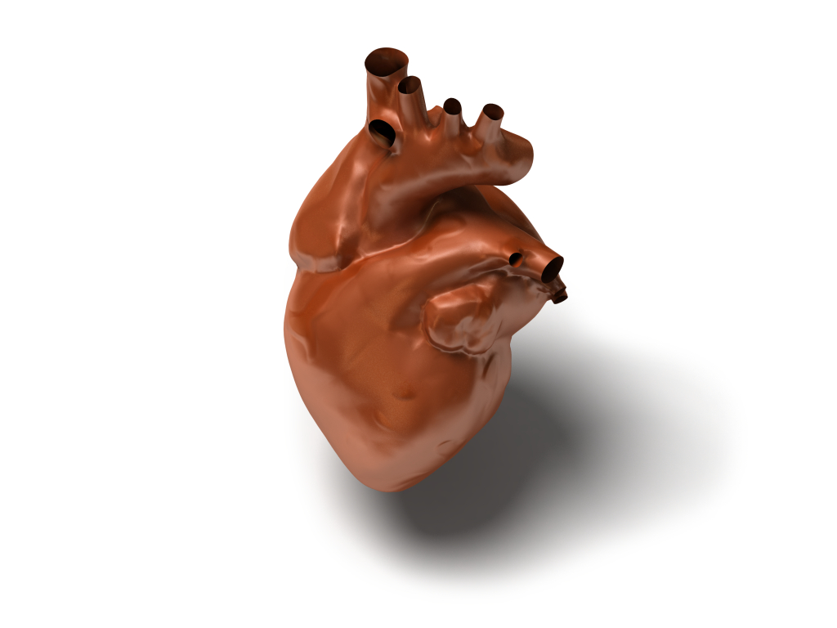
Ten Minutes About:
Inflammatory Cardiomyopathy (Myocarditis)
Morgen Meier
Alverno College
Spring 2012
MSN 621
Microsoft Clip Art

Slide 2
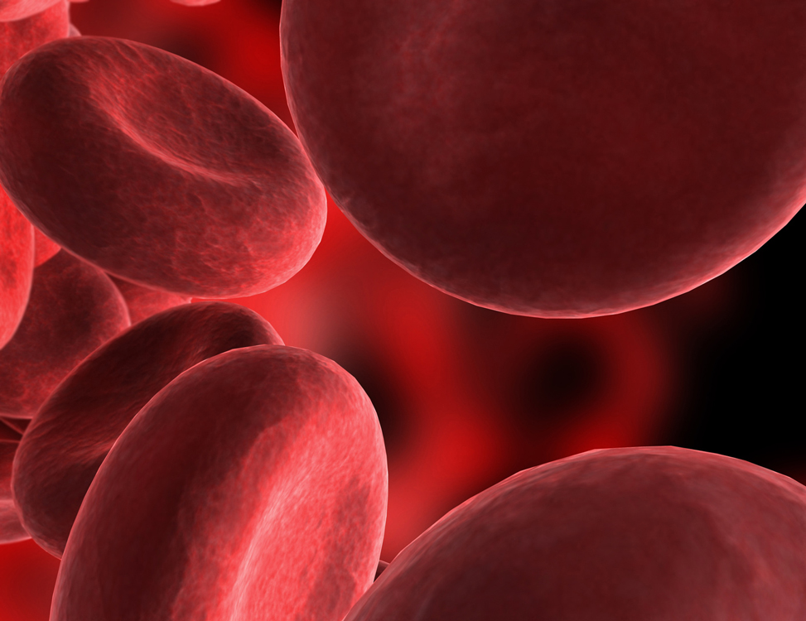
Myocarditis – “Heart Inflammation”
A 32 year-old man presents to the ER. He has complaints of chest pain, shortness of breath (SOB), and tachycardia with a heart rate of 125 beats per minute . The man’s electrocardiogram (EKG) is positive for ST segment elevation. He has complaints of fatigue and generalized weakness since getting over a reported “virus” a week ago; previous to getting sick, the man says that he was an exercise fanatic, he had been training for a triathlon. The man also comments that he has gained 5 pounds in the last 2 days despite having a limited appetite. ER staff note 2+ pitting pedal edema during examination and the man comments that his shoes have been “fitting tight”. Lab results confirm troponin – T is elevated 2.1 µg/L, as is BNP 689 pg/mL. The man had a coronary angiogram, with normal results. What do you think an echocardiogram would show? Why?
Microsoft Clip Art

Slide 3
Outcomes
Understand pathophysiological causes and medical symptoms of myocarditis
Identify diagnostics that are useful in confirming the diagnosis of myocarditis
Comprehend various treatment options for various classes of myocarditis
Microsoft Clip Art

Slide 4
Causes and Medical Symptoms
Often related to an illness (2, 4, 6, 7, 8)
  Viral infections most common, but can be bacterial, autoimmune, fungal
    Most common cause is enterovirus
No typical presentation, often diagnosed after other causes ruled out (2, 4, 6, 7, 8)
  May be asymptomatic
  May present with symptoms of heart failure or acute myocardial infarction
    Patient history and negative tests often lead to “gold standard” of diagnosis, the endomyocardial biopsy
Microsoft Clip Art

Slide 5
Causes and Medical Symptoms
Symptoms may differ with 3 classes (2, 5)
  Acute – less distinct onset, cardiovascular compromise not initially as severe, BUT often do not fully recover and may develop dilated cardiomyopathy
  Fulminant – distinct onset following illness, severe cardiovascular compromise, BUT often resolves if the patient survives
  Chronic – less distinct onset, persistent inflammatory changes, less chance of ventricular dysfunction than acute
Microsoft Clip Art

Slide 6
Question about Myocarditis??
Back to the first question…
what would
this man’s echocardiogram likely show?
What symptoms lead you to your answer on the above question?
Why do we know this man’s primary diagnosis should not be heart failure, and more testing is needed?
Click Below for Answer
Heart failure
Click Below for Answer
SOB, tachycardia, edema, others
Click Below for Answer
Symptoms acute; recent “virus”
Case Study Link
Microsoft Clip Art

Slide 7
Questions about Myocarditis??
Which class of myocarditis causes the most cardiovascular compromise, BUT may lead to a complete recovery if the patient survives?
What is the most common viral cause of myocarditis?
What diagnosis
often develops
after a patient
develops acute
myocarditis?
Click Below for Answer
Enterovirus
Click Below for Answer
Dilated Cardiomyopathy
Click Below for Answer
Fulminant
Case Study Link
Microsoft Clip Art

Slide 8
The Role of the Inflammatory and Immune Response in Myocarditis
Acute viral infection (phase I) -> Autoimmune activation (phase II) -> Ongoing Myocardial Injury (phase III) (7)
The virus (phase I) + The immune response (phase 2) = The inflammatory response (7)
Review!!!
Immune Response
Inflamm-atory
Response
Microsoft Clip Art

Slide 9
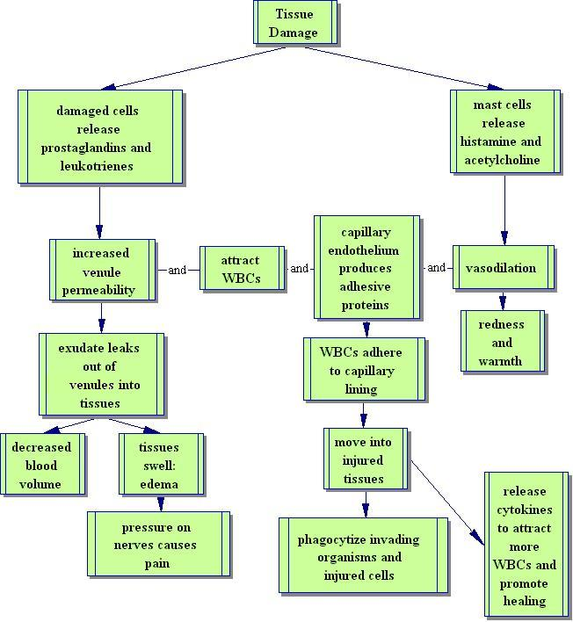
The Inflammatory Response
Image utilized with permission (Bowne, 2004).

Slide 10
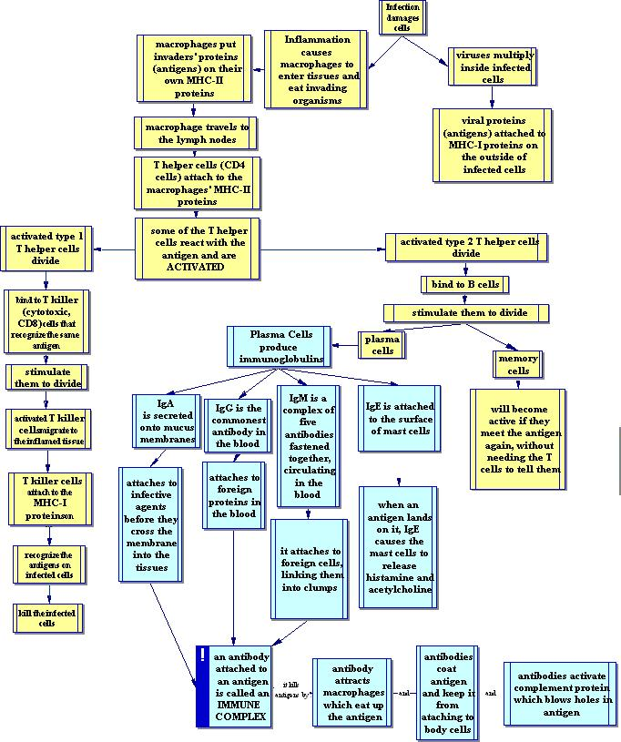
The Immune Response
Image utilized with permission
(Bowne, 2004).

Slide 11
Diagnostics and Testing
Chest x-rays (CXR), EKGs, coronary angiograms, blood cultures, cardiac enzymes, cardiac MRIs, while often negative or non-specific when coupled with the patient’s history rule out other diagnoses (i.e. acute myocardial infarction, heart failure, pulmonary embolus)
(2, 4, 6, 7, 8)
Endomyocardial biopsy remains the “gold standard” for diagnosing myocarditis (2)
  The “Dallas Criteria” are criteria by which biopsies are interpreted:
    Borderline myocarditis – the inflammatory infiltrate is limited or myocyte injury absent
    Active myocarditis - “inflammatory infiltrate of the myocardium with necrosis and/or degeneration of adjacent myocytes not typical of the ischemic damage associated with coronary heart disease” (Cooper, 2012, p. 7).
Microsoft Clip Art

Slide 12
Questions about Myocarditis??
What are some other tests that may help with the diagnosis?
Why are these tests needed in diagnosing myocarditis?
What is the “gold standard” for diagnosing myocarditis?
Click Below for Answer
Rule out other diagnoses ; no typical clinical presentation
Click Below for Answer
Angiogram, CXR, blood cultures, others
Click Below for Answer
Endomyocardial biopsy
Case Study Link
Microsoft Clip Art

Slide 13
Questions about Myocarditis??
What is the name of the criteria used for histologic examination of endomyocardial biopsies?
______ has limited inflammatory infiltrate or limited myocyte damage.
______ has positive inflammatory infiltrate AND necrosis or degeneration of myocytes.
Click Below for Answer
The Dallas Criteria
Click Below for Answer
Borderline Myocarditis
Click Below for Answer
Active Myocarditis
Case Study Link
Microsoft Clip Art

Slide 14
Treatment ~ Medications
Antibiotics - treat the infection if there is a bacterial cause (3)
Antiviral therapy - has limited effects unless started prior to infection or very soon following (3)
Corticosteroids - may help to limit the inflammatory response (3)
Diuretics - may improve fluid retention associated with cardiovascular compromise (3)
Beta-blockers and ACE-inhibitors - limit worsening of cardiovascular instability for those that have developed dilated cardiomyopathy (3)
Anticoagulants - for clot prevention in patients who have developed severe heart failure or arrhythmias such as atrial fibrillation (3)
Microsoft Clip Art

Slide 15
Treatment ~ Therapies & Non-Medicine Interventions
Low salt diet - may improve fluid retention associated with cardiovascular compromise (3)
Reduced activity - allows the heart to “heal”, more acute cases will likely require cardiac rehab (3)
Cardiac assistive devices may be necessary to correct an arrhythmia (3)
Severe chronic myocarditis with ongoing heart failure may qualify for a heart transplant (3)
Microsoft Clip Art

Slide 16
Questions about Myocarditis??
The man in the case-study has fulminant myocarditis, is part of his initial treatment to receive a heart transplant? If no, why not?
_________ decrease the inflammatory response, limiting further myocardial injury.
_________
may improve the
man’s SOB and
fluid retention.
Click Below for Answer
No, because fulminant cases may fully recover
Click Below for Answer
Corticosteroids
Click Below for Answer
Diuretics, i.e. Lasix, etc.
Case Study Link
Microsoft Clip Art

Slide 17
Question about topic
This man has fulminant myocarditis, the most likely class to recover fully. Can this man return to triathlon training when he is discharged?
If the man above recovers fully, does he need anticoagulants when he is discharged?
______ have limited effects; they may be helpful if they are initiated prior to the infection, or very soon after.
Click Below for Answer
No. This is typically for arrhythmias and severe heart failure
Click Below for Answer
No, rest is needed initially to treat
Click Below for Answer
Antivirals
Case Study Link
Microsoft Clip Art

Slide 18
Summary
Onset of disease preceded by illness (2, 4, 6, 7, 8)
Three classes: acute, fulminant, chronic (2, 5)
There is no typical presentation; a “rule out” diagnosis (2, 4, 6, 7, 8)
The inflammatory and immune responses contribute to severity (7)
Endomyocardial biopsy using the Dallas Criteria is the definitive testing for diagnosis (2)
Treatment varies by the severity and the symptoms present in the individual patient (3)
Microsoft Clip Art

Slide 19
Literature Cited
1. Bowne, P. (2004). Patho. Retrieved from http://faculty.alverno.edu/bowneps/.
  Inflammatory Response. Retrieved from http://faculty.alverno.edu/bowneps/inflammation/inflammprint.htm
  Immune Response. Retrieved from http://faculty.alverno.edu/bowneps/immune/immunequizprint.htm
2. Cooper, L.T., (2012, Jan). Clinical manifestations and diagnosis of myocarditis in adults. Retrieved from http://www.uptodate.com/contents/clinical-manifestations-and-diagnosis of-myocarditis-in adults?source=search_result&search=inflammatory+myocarditis&selectedTitle=3%7E150
3. Cooper, L.T., (2012, Jan). Natural history and therapy of myocarditis in adults. Retrieved from http://www.uptodate.com/contents/natural-history-and-therapy-of-myocarditis-in-adults? source=search_result&search=inflammatory+myocarditis&selectedTitle=2%7E150
4. Mayo Clnic. (2010, Mar 16). Retrieved from http://www.mayoclinic.com/health/myocarditis/S00521
5. McCarthy, R.E., Boehmer, J.P. , Hruban, R.H., Hutchins, G.M., Kasper, E.K ., Hare, J.M., & Baughman, K.L. (2000). Long-term outcome of fulminant myocarditis as compared`with acute (nonfulminant)myocarditis. New England Journal of Medicine, March 9, 2000, p. 690 695. doi:10.1056/NEJM200003093421003
6. Medline Plus. (2012, Feb 28). Retrieved from http://www.nlm.nih.gov/medlineplus/ency/article/000149.htm
7. Porth, C.M. & Marfin, G. (2009). Pathophysiology: Concepts of altered health states. Philedelphia: Lippincott, Williams & Wilkins.
8. Pub Med Health. (2010, May 4). Retrieved from http://www.ncbi.nlm.nih.gov/pubmedhea
th/PMH0001204/
Microsoft Clip Art

